Slide 1
SSDS and Rostering API
School Data Sync
Questions: brand@microsoft.com

Slide 2





Microsoft School Data Sync
A Service in Office 365 Education
Office 365
Automatic group and class site creation
Class Rosters
Students
Class Info
Class Info
Single
Sign
On
Teachers
Azure Active Directory & Office 365 Platform
Sync and Management tools for School IT
SIS
Notes:
School Data Sync, which will be included in Office 365 Education, will mirror user profiles and class rosters from a Student Information System into Office 365. It models classrooms within Office 365 as Groups and Group sites, so teachers can easily manage classes and class materials. Our objective is to:
help teachers save time by automatically creating groups and enabling single sign on to apps in the classroom
help schools and districts save money by working with existing technology investments to reduce the time IT admins spend managing groups, troubleshooting, and auditing security
help ISVs by providing a single, free, platform and API to connect their applications to SIS data
help SIS providers by providing a single, free, platform API to connect to LMS and other classroom apps
Help increase school and student security and privacy by creating a single, secure source for identity and central control over which data gets shared and where.
------
We designed School Data Sync to help the entire education partner ecosystem.
SIS Vendors
SIS vendors will be able to support more apps with integration through a single API, allowing them to more efficiently provide access to classroom data.
ISV’s
Third party applications will be able to use an encrypted connection to access the student data to personalize learning experiences, all at no charge via cloud APIs, and let students enjoy the benefits of sign-on with Office 365.
With School Data Sync, ISVs will be able to deliver SIS independent applications, speeding time to market while reducing support and infrastructure costs.
Security & Privacy
Because security and privacy are so important, School Data Sync will let the district determine which apps can access school and student data and which data gets shared so they can remain in compliance with their policies.

Slide 3











Office as a development platform
Office UX Add-ins and compatible applications
Office Graph APIs | http://graph.microsoft.com
Mail
Files API
Voice & Messaging
Tasks
Video
Conversations
Calendar
Trends
Meetings
Contacts
Analytics
Assignments
School Data Sync
School Information System
Directory Graph APIs
Directory Graph APIs
Office 365 Groups
Users & Relationships
Azure Active Directory
Users & Relationships
Office 365 Groups
Authentication & Access
Azure Active Directory
(Classes)
+Teachers, Students, Admins, and Schools
Authentication & Access
Notes:
Getting roster data from your SIS into Office 365 and other cloud classroom apps today presents a number of challenges.
Multiple Logins takes away instruction time, can increase helpdesk calls, and create security vulnerabilities
Multiple APIs means writing, testing, and supporting multiple connections to SISs, costing time and money
Keeping student and teacher data secure and private becomes more challenging when so many apps and users need access to the information
(click to build)
School Data Sync with Azure Active Directory and Office 365 helps improve the apps and solutions you already use, without requiring new investments, by:
Providing a single, no cost API to give applications access to data from SIS providers and platforms a
Improve the classroom experience of your applications by enabling single sign on and access to other information in the Office graph such as calendar, contacts, etc.
Easier roster creation and integration by creating relationships between Office 365 groups, or Classes, and Azure Active Directory entities such as teachers, students, and schools
Helps increase school and student security and privacy by creating a single, secure source for identity and central control over which data gets shared and where.
Schools do not need to throw out their existing investments and move entirely to the cloud, either, For schools with on-prem AD or hybrid environments, they can use Azure Active Directory Premium (AADP)

Slide 4
Requirements
Tenant must be Office 365 Education
Must be licensed for SharePoint & Exchange Online
Licenses can be assigned when creating accounts
SDS will still sync account info for unlicensed users
Synced account can be used when licenses assigned
Notes:
NOTE: BASED ON PREVIEW PRODUCT
Your Office 365 tenant must be an Office 365 Education tenant.
Synced identities must be licensed for SharePoint Online and Exchange Online. Skype for Business licenses aren't required. Note that OneDrive for Business is provided through the SharePoint Online license.
If a student or teacher doesn't have the required licenses in Office 365, School Data Sync will still create their profile, but Class Dashboard will not finish provisioning properly for them for any apps they aren't licensed to use.
If you're not deploying or utilizing a tenant with synced identities, you can create new cloud identities for teachers and students, and license them for services through SDS

Slide 5
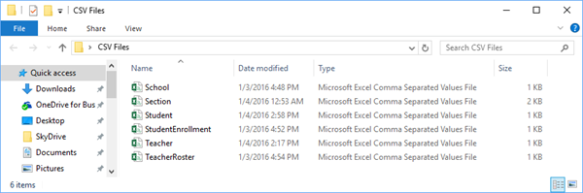
Deployment Options
Built in sync using REST API for supported SIS’s
PowerSchool
Clever
CSV files for all others
School.csv – School information
Section.csv – Section information
Student.csv – Student information
Teacher.csv – Teacher information
StudentEnrollment.csv – Student to Section mapping
TeacherRoster.csv – Teacher to Section mapping
Please see Deploying School Data Sync support article
Notes:
NOTE: BASED ON PREVIEW PRODUCT
You can create the CSV files manually, extract them from the SIS database, or create them with help from the SIS vendor. The CSV content and formatting must be the same, regardless of how you create the files. If you need assistance with the data extraction, check with your SIS provider for support.
The six required CSV files are:
School.csv – School information.
Optional attributes for School.csv
Section.csv – Section information.
Optional attributes for Section.csv
Student.csv – Student information.
Optional attributes for Student.csv
Teacher.csv – Teacher information
Optional attributes for Teacher.csv
StudentEnrollment.csv – Student to Section mapping.
TeacherRoster.csv – Teacher to Section mapping
Note: These CSV files must be named exactly as shown, and all be contained within the same folder or directory on the local machine. No other files should exist in this directory. Also, each attribute name shown below for each CSV file will be configured as a header, within each of the respective CSV files

Slide 6
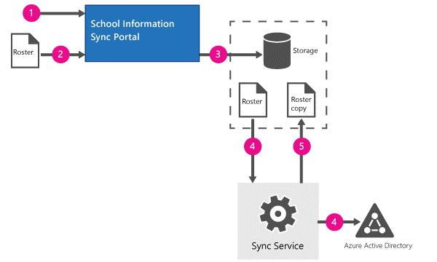
Initial Sync- CSV Deployment
CSV files are validated
Accounts provisioned in Azure Active Directory
Sync profile created
CSV files uploaded
Files validated and stored
Roster data synced with AAD
Copy of roster saved
Notes:
NOTE: BASED ON PREVIEW PRODUCT
Once you create a sync profile and enable sync, School Data Sync will do the following:
New Profile is created in the SIS portal.
Initial set of CSV files are uploaded.
Sync validates and stores these files.
The data from these files is synchronized with Azure Active Directory.
Once all data has been synchronized, a copy of the teacherroster.csv and studentenrollment.csv files are saved

Slide 7
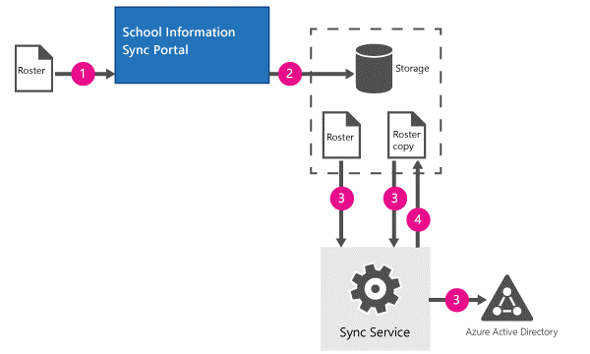
Subsequent Syncs- CSV Deployment
New roster compared to the saved roster
Adds or removes teachers and students
New CSV files uploaded
Files validated and stored
Sync compares new data to saved
New data added*
Deleted data removed*
New copy of roster saved
*Sections and schools do not get deleted, only group members and owners
*Sync does not delete accounts from Azure Active Directory
Notes:
NOTE: BASED ON PREVIEW PRODUCT
After your first sync, data within your SIS will inevitably change. The change may be related to a student, teacher, section, or any of the other attributes and objects types configured with School Data Sync. Some changes may occur on a daily basis. In order for changes in the SIS to be reflected in School Data Sync and Class Dashboard, the data needs to be updated through the sync process.
Roster based membership updates
The section membership is defined by the roster. Student rosters are defined in the StudentEnrollment.csv, and teacher rosters are defined in the TeacherRoster.csv. Sync will keep the section membership updated based on these roster files. Whenever users are removed from their roster file, Sync will remove the user from the corresponding section (group) and school (administrative unit). Sync calculates the differences by comparing the new roster file with a previous version of the same file.
New studentenrollment.csv and teacherroster csv files are uploaded.
Sync saves the files.
During the synchronization, the data between the existing set of files (from step #5 of the initial sync) are compared to the new files.
If entries are added in the new set, but absent in the previous set, then these users will be added to the respective section.
If entries are removed in the new set, but present in the old set, then these users will be removed from the section.
After a successful sync, the new set of files overwrites the earlier files (from step# 5 Initial Sync).
Additional notes
No sections or schools are deleted in this sync flow, only group members and owners are updated.
Providing a complete roster with all current enrollments, on every upload, will ensure an updated roster across all sections.
If a student is deleted in the student.csv , Sync does not delete the Azure Active Directory account for that student.
If a teacher is deleted in the teacher.csv, Sync does not delete the Azure Active Directory account for that teacher.
If classes are deleted in the section.csv, Sync does not delete the Unified Group in Azure Active Directory.
If a new teacher is added to a class in the teacherroster.csv, that teacher is added as a group owner.

Slide 8
Demo – School Data Sync
brand@microsoft.com

Slide 9
School Data Sync Toolkit
Use to:
Validate CSV files and check for errors
Perform a manual CSV sync from PowerShell
Automate CSV sync processes via PowerShell
Download: http://download.microsoft.com/download/9/2/8/928EF7C5-4894-4D4C-BF4A-893C22D77C00/Microsoft%20School%20Data%20Sync%20Toolkit.msi
Notes:
NOTE: BASED ON PREVIEW PRODUCT

Slide 10
Microsoft School Data Sync
Saves Time
Automatic roster creation with synchronized SIS data
Automatically reflect class membership updates
Single sign-on reduces login time and troubles
Saves Money
Automates creation of digital classrooms
Reduces teacher and IT burdens
Integrates with your existing investments
Enterprise Performance
Built on proven Azure and Office 365 Cloud Platform
Designed by education pros for education customers
IT has control over security and privacy
Notes:
So what does all this mean?
Well, for schools and districts, and especially those that use Office 365, Microsoft introducing School Data Sync means you will save time and money and get enterprise grade performance and reliability in a solution tailored for education.
Saves Time
Teachers will save time because online classrooms are updated automatically- teachers do not need to do it manually at the beginning of term or when there are changes
Admins will save time because rosters are created automatically based on information stored in the Student Information system, so they can use a single source of truth to automatically create rosters for all classes and compatible applications.
Even students will save time thanks to single sign on, where they can sign on once and access all their resources.
Saves Money
Your district will save money because IT admins can spend less time creating rosters and more time on important IT projects. Helpdesk costs can go down too with fewer password and access issues due to single sign on. finally, the solution works with what you already have today- no need to buy new devices or software to get the benefits.
Enterprise Performance
The solution has been tailored for education customers with input from schools, teachers, admins, SIS providers and ISVs in education, but is built on the scalable, reliable, and secure Office 365 and Azure Active Directory platforms from Microsoft. These services have been proven by hundreds of millions of users around the world. Having a single connection to SIS data helps reduce privacy risks Your IT will have ultimate control over what gets synchronized and which apps can access the information,

Slide 11
School Data Sync- Next Steps
Requirements
Office 365 Education
SharePoint Online
Exchange Online
U.S. Preview Sign Up
http://aka.ms/sdsconfirmation
Compatible Apps
Check with your SIS Provider
Check with your App Vendors
More Information- http://sds.microsoft.com
Notes:
School Data Sync is just part of Office 365 Education. Your school or district will need to make sure you are licensed for Office 365 education as well as sharpeoint online and Exchange online.
You can sign up for the School Data Sync preview at http://aka.ms/sdsconfirmation. Note that School Data Sync is not available in all countries yet.
Microsoft is working with many of the most common SIS providers and app vendors. A list of Office 365 compatible apps can be found on the office store at http://store.office.com. However, some apps may work with SDS without our knowledge, or others may not have been added to the list yet, so please check with your SIS vendor and the vendors of the apps you use in your school to see if they are compatible if you do not see them on our list.
For more information and other important links, please visit http://sds.Microsoft.com

Slide 12
Schools REST API
Properties are implemented as custom attribute extensions
(extension_fe2174665583431c953114ff7268b7b3…)
Entities are standard AAD semantics
Schools - Administrative Units
Sections - Unified Groups
Students – users with the ".._Education_ObjectType“ = "Student"
Teachers – users with the “…_Education_ObjectType“ = “Teacher"

Slide 13
OData Queries to Search
Find all students
…/users? &$filter={eduExtensionId}_ObjectType%20eq%20'{eduObjectTypeStudent}’
Get students and teachers in section
$"groups/{sectionId}?api-version=beta&$expand=members
See: https://msdn.microsoft.com/en-us/office/office365/api/complex-types-for-mail-contacts-calendar#use-odata-query-parameters

Slide 14

Questions?

